Slide 1

Knowledge, Attitude, and Practices of HPV
Vaccination among Mothers of Preteen Age Girls
Attended to at Thika Level 5 Hospital
Kiteki Gibson Hsm2111-0069/2018
Patrick Kisio Hsm211-0064/2017
Benter Achieng Hsm211-0324/2017
Margaret Njambi Hsm211-0197/2016
Juliet Sisso Hsm211-0073/2018
Supervisor
Dr. Michieka

Slide 2
Contents
Background information
Statement of problem
Justification
Objectives
Conceptual framework
Materials and methods
Data collection and analysis
Results
Discussion
Conclusion
Challenges
Recommendations

Slide 3
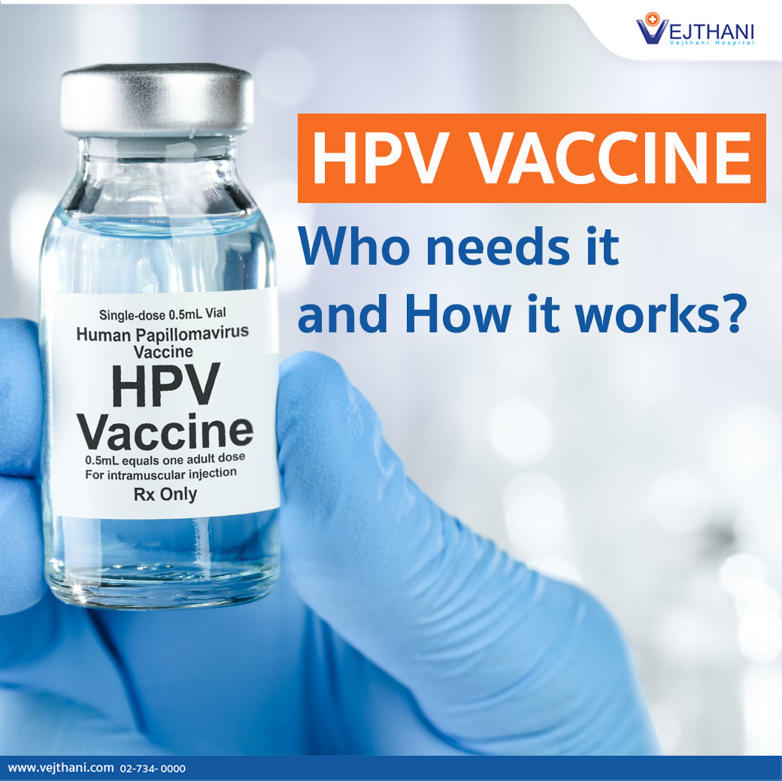
Background Information
HPV is of the most common type of STIs
It has over 200 strains.
Some strains of HPV (mostly 16 and 18) cause cervical dysplasia/cancer.
However, cervical cancer is preventable through HPV vaccination.
Vaccines available: bivalent (Cervarix) and quadrivalent (Gardasil) vaccines.
Girls aged 9-14yrs should receive two doses at minimum interval of six months (WHO).
Notes:
The most common types are types 6 and 11, which cause around 90% of genital warts, and types 16 and 18, which are high-risk and contribute to approximately 70% of cervical malignancies
The bivalent vaccine targets HPV types 16 and 18, while the quadrivalent vaccine targets HPV types 6, 11, 16, and 18.

Slide 4
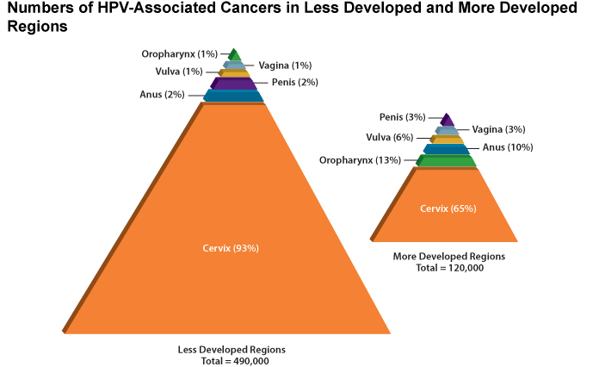
Statement of the Problem
Cervical cancer is the leading cause of cancer deaths in women.
Over 90% of these deaths occur in low-income countries like Kenya (Karanja Chege 2022).
Only 33% received the 1st dose in 2020 and only 16% returned for the 2nd dose in 2022.
The low uptake it’s due to lack of knowledge and misinformation about immunization.
In KCRH there’s lack of data showing the education of mothers of pre-teen girls.
In 2018, 43 million cases of HPV were registered among teens and early 20s
Source: http://www.ncbi.nlm.nih.gov/pubmed
Notes:
In 2018, an estimated 570 000 women were diagnosed with cervical cancer worldwide and about 311 000 women died from the disease

Slide 5
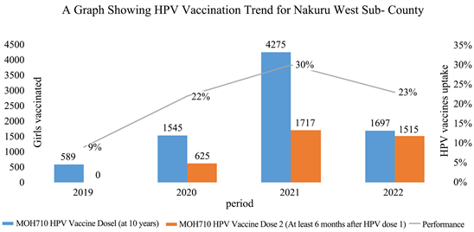
Justification
HPV vaccine uptake in Kenya is low
Only 35% took first dose and only 10% completed the two-doses in 2019
Mothers of the preteen girls are the best conduit to contact pre-teens about HPV vaccines.
Yet they have inadequate KAP about HPV vaccination.
Globally in 2020, there were an estimated 604 127 cervical cancer cases and 341 831 deaths(WHO).
A rise from 570, 000 cases and 311 000 deaths
Source: https://www.scirp.org/
Notes:
The data collected from mothers of preteen girls attending Thika Level five will provide insight into the knowledge, attitude and practices of HPV vaccines among mothers of pre teen girls.

Slide 6
Objectives
Broad Objective
To assess the knowledge, attitude, and practices of HPV vaccination among
mothers of pre-teen girls attended at KCRH.
Specific Objective
To determine the level of knowledge among mothers of pre-teen age girls about HPV vaccination.
To explore the attitudes of mothers of preteen girls toward HPV vaccination
To describe the current practices of mothers regarding HPV vaccination
N/B Research questions were based on the specific objectives
Notes:
What is the level of knowledge among mothers of pre-teen girls attending Thika Level 5 hospital regarding HPV vaccination?
What are the attitudes of mothers towards HPV vaccination for their pre-teen age daughters?
What are the current practices of mothers regarding HPV vaccination for their pre-teen age daughters?

Slide 7
Conceptual framework
Independent variables
Intervening variables
Dependent variable
Knowledge
Maternal age and education
Maternal religion
Marital status
Practices (HPV uptake)
Attitude

Slide 8
Materials and Methods
Study site: Kitale County Referral Hospital
Study Design: Cross sectional study.
Study population: Mothers of pre teen girls attending KCRH
Inclusion : Mothers who will consent to participate in this research
Exclusion : Mothers who will not take part in this research or fails to consent to it.
Sample size calculation: Yamane’s formula (n=N/(1+N(e)²)= 150 mothers
Sampling method: Simple random sampling
Notes:
Conceptual framework
Dependent variable: HPV Uptake
Independent variable: Knowledge, Attitudes and Practices

Slide 9
Data Collection and Analysis
Project was approved by JKUAT Ethics and Research committee
Informed consent was also sought
Collection tool : Self-admistered questionnaires/ Excel worksheet
Data management : The data collected was securely kept:
Hard and soft copies in password encrypted electronic devices.
Data analysis: SPSS software

Slide 10
Results: Demographics
Results: Demographics
Education:
Primary- 32.7%, secondary-42.7% Tertiary-24.7%
 |  | Frequency | Valid Percent
 | Primary level | 49 | 32.7
 | Secondary level | 64 | 42.7
 | Tertiary | 37 | 24.7
 | Total | 150 | 100.0
Age of participants: 34-45 yrs (38.7%), 25-35 yrs (36%)
Age of the participant
 |  | Frequency | Valid Percent
 | Below 25 years | 5 | 3.3
 | 25-35 years | 54 | 36.0
 | 35-45 years | 58 | 38.7
 | 45-55 years | 27 | 18.0
 | Above 55 years | 6 | 4.0
 | Total | 150 | 100.0
Married- 77.3% & 22.7% single
Christian- 83.3% & non-Christian- 16.7%

Slide 11
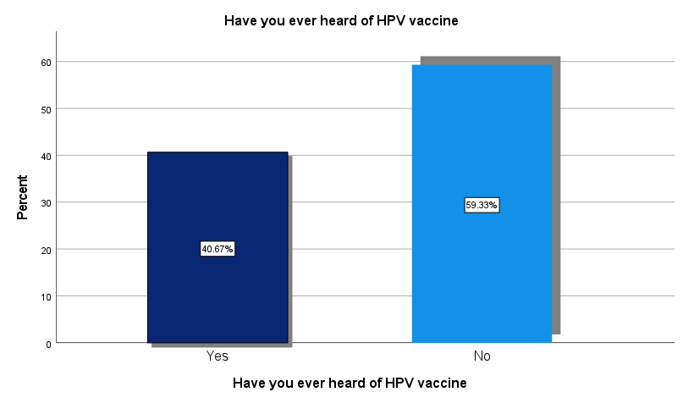
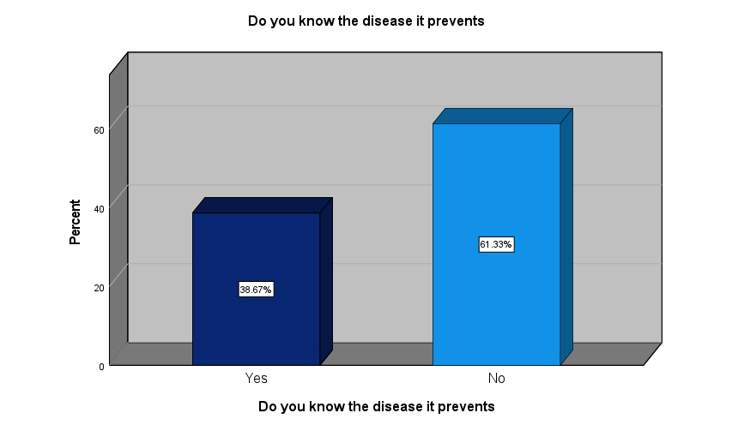
Results: Knowledge
Familiar with HPV virus: 40%
Knew the associated disease: 28.7%
Knew mode of transmission: 27.3%
Heard of HPV vaccine: 40.67%
Knew disease vaccine prevents: 38.67%
Knew route of administration: 34%
Knew age group: 25.33%
Knew number of doses: 27.33%

Slide 12
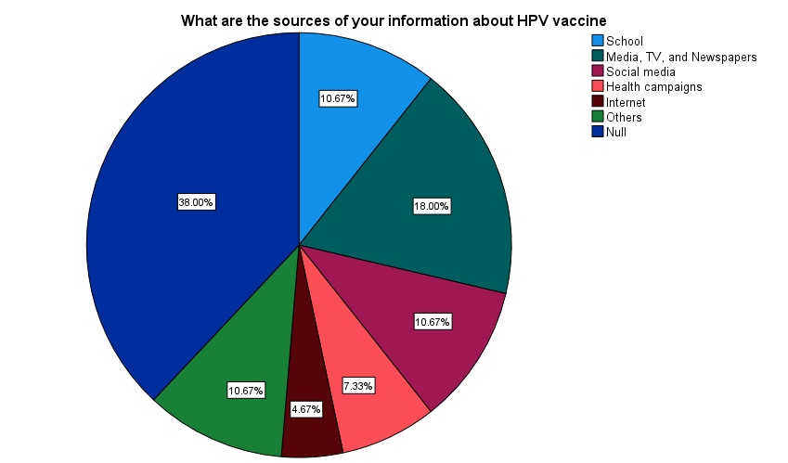
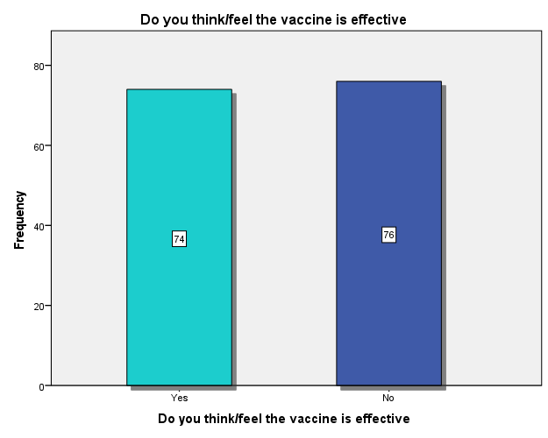
Results: Knowledge
Majority of the participants; 72.7%, knew where to access the vaccine.
About 50.7% of the participants did not believe in vaccine efficacy.
Only 13.33% felt they have enough info”
Alarmingly, 86.7% had no dependable source of info” about HPV and vaccine.

Slide 13
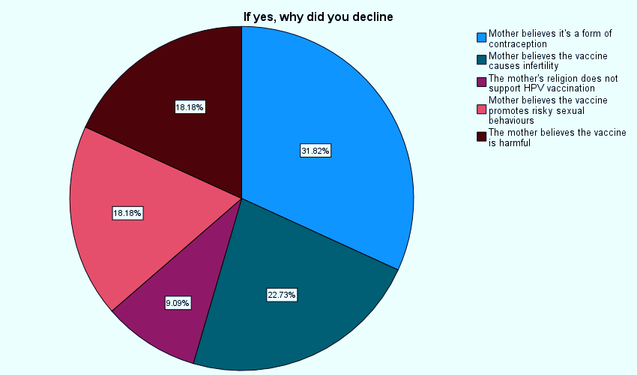
Results: Attitude
Only 22 (14.7%) declined the HPV vaccine.
Majority (31.8%) stated they believed it was a mode of contraception.
50.7% reported had fears
81.3% were willing to have more knowledge
63.3% advocated for HPV education in schools
54.67% believe benefits outweigh risks

Slide 14
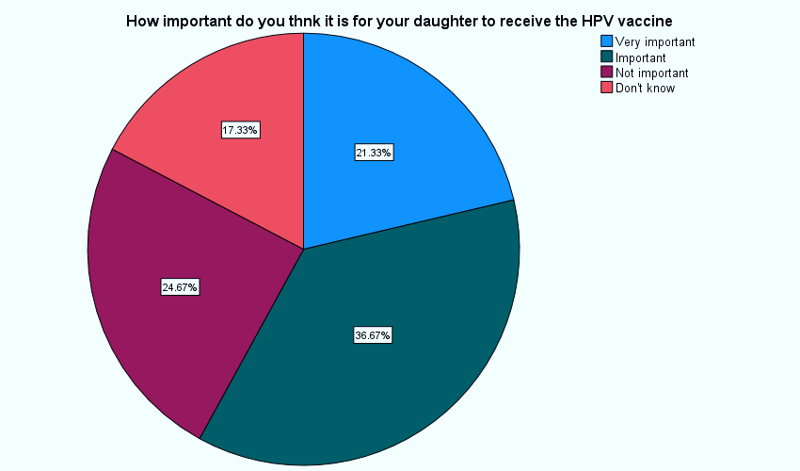
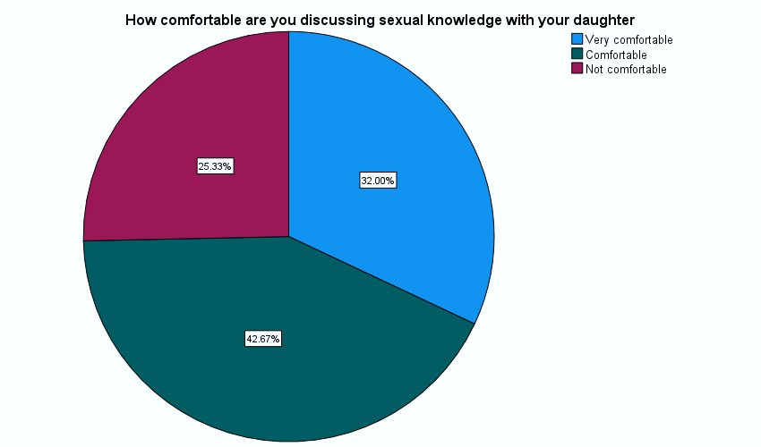
Results: Attitude
Majority, 58%, thought the vaccine is important
Majority, 74.67%, were comfortable discussing sexual life with their daughters

Slide 15
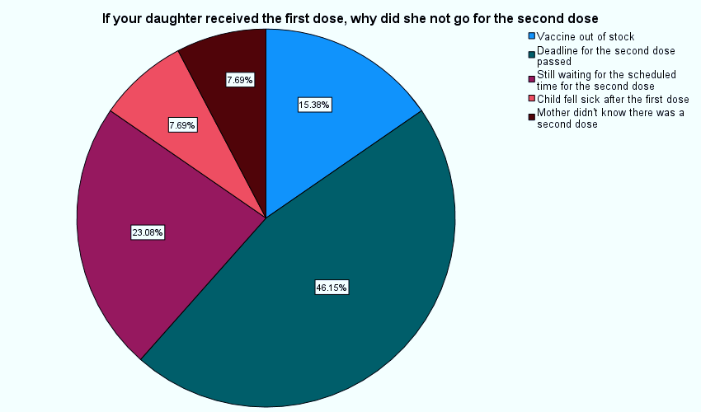
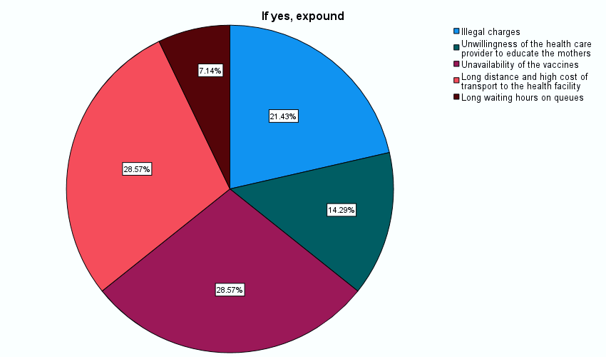
Results: Practice
Only 26% had vaccinated
One dose-33.3% & two doses-66.7%.
Majority, 46.15% missed 2nd dose since deadline passed.
Out of 32% who attempted to vaccinate18.67% experienced barriers
Most common barriers: Unavailability of vaccine and long distance.

Slide 16
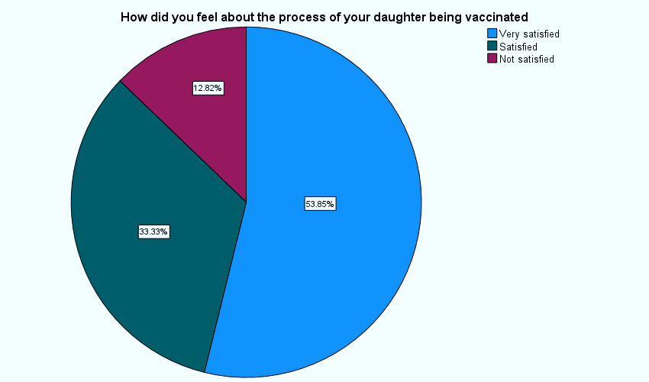
Results: Practices
Only 18.35% were planning on future vaccination
Disturbingly, only 30.67% inquired about HPV vaccine
70.67% wouldn’t recommend the vaccine to other mothers
Only 14.67% had participated on a similar study
Majority of those who vaccinated their daughters,87.18%, were satisfied with the process.

Slide 17
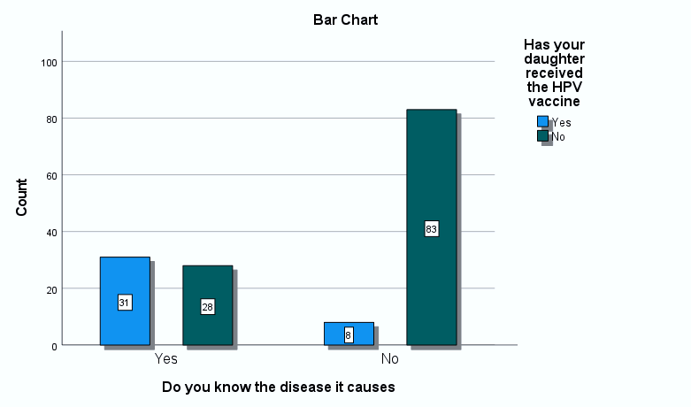
Results: Correlation
31/39 mothers who vaccinated their daughters reported to know the disease
Mothers who held tertiary education were more distributed between age brackets 25-35 years (35.2%) and 35-45 years (59.6%).
31/59 mothers aware of the disease HPV causes had attained tertiary education
23/39 girls who received the vaccine were born to mothers with tertiary education
 |  | Received HPV vaccine |  | Total
 |  | Yes | No
Education level | Primary level | 1 | 48 | 49
 | Secondary level | 15 | 49 | 64
 | Tertiary | 23 | 14 | 37
Total |  | 39 | 111 | 150

Slide 18
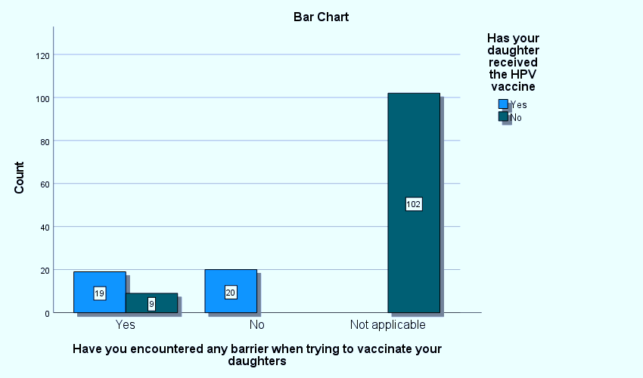
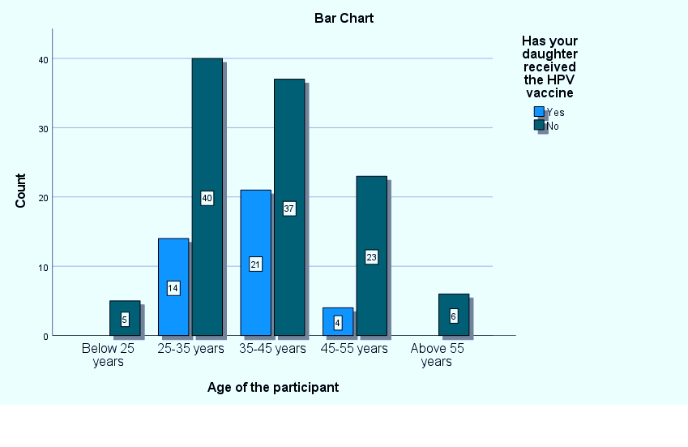
Results: Correlation
82.1% of mothers who had vaccinated had heard of HPV vaccine
9/28 mothers who experienced barriers didn’t vaccinate
22 (100%) mothers who had previously participated in similar studies would had heard of HPV vaccine
Marital status, age, and religion didn’t have significant impact on vaccine uptake

Slide 19
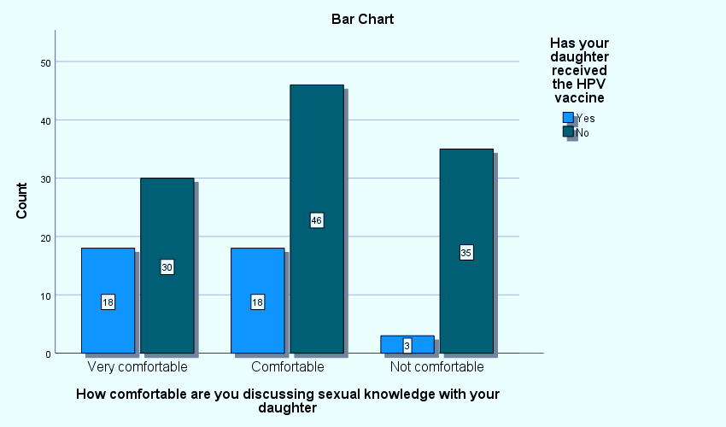
Results: Correlation
36/39 mothers who vaccinated were comfortable discussing sexual life with their daughters
Majority of mothers (20/38) not comfortable discussing sexual life had only attained primary education
97.4% of mothers who had vaccinated would recommend to other mothers
20/22 mothers who declined HPV vaccine reported having fears about the vaccine
 |  | Having any fears regarding HPV vaccination |  | Total
 |  | Yes | No
Declined HPV vaccination | Yes | 20 | 2 | 22
 | No | 56 | 72 | 128
Total |  | 76 | 74 | 150

Slide 20
Discussion
Demographics
↑maternal age = ↓ knowledge and decreased willingness to vaccinate
Differs from the findings of Chen et al (2023)
Maternal education level played a bigger role in daughters vaccination
Agrees with the findings of Chen et al (2023), Gerend and shepherd (2022) , & Tiro et al (2007).

Slide 21
Knowledge
About 40% had heard of the virus and vaccine
Similar to the findings of Sinshaw et al(2022).
Almost half of the participants (49.3%) believed the vaccine was effective
Similar finding in an study in Malaysia (49.1%) (Rashwan et al, 2009).
Ogengo ( 2022) found out that 19.9% & Mburu et al found 17.2% knew mode of transmission
Differs from our finding of 34%

Slide 22
Attitude
Most participants had a positive attitude towards the vaccine (85.3%)
Ogengo (2021) found 63% had +ve attitude.
Most of the participants declined the vaccine because they believed it was a form of contraception (31.8%).
Njuguna et al found the same.
Most of the participants were willing to acquire more knowledge about HPV and its vaccine.
This was also a finding by Kolek et al (2022)

Slide 23
Practices
Only 26% had vaccinated their daughter (one or two doses)
Karanja Chege (2022) , finding: 25% in 2019 and 33% in 2020.
Majority of those vaccinated had received full doses (74%).
Differs from the findings of Naoum et al (2022) (36%).
Majority of the mothers who had vaccinated their daughters recommended the vaccine to other mothers.
a similar finding by Sinshaw et al (2022) ( 3 times more likely )

Slide 24
Conclusion
There is a notable gap in knowledge​
Mothers lack awareness of HPV and HPV vaccination.​
There is fear in regards to the role and safety of the vaccine.​
A large proportion of mothers have not vaccinated their daughters.​
Promote educational interventions to increase awareness of virus and vaccine.

Slide 25
Recommendations
Challenges
Language barrier
Reluctance to participate
Lack of analytical skills
Financial constraints
Exclusion and inclusion criteria
Increase exposure to information.
Sexual/HPV education in schools
Screening of eligible patients vaccination records.
Set reminders to be sent via calls, texts messages and emails.
Equip peripheral facilities with the vaccine.
Inform mothers about the vaccine during the postnatal clinics.
Work with community leaders to reduce myths and misconceptions.

Slide 26
Timelines and work plan
Dec-Jan 2023
Feb-March
April-May
June-Nov
Research topic Ideation
Scope and goal setting
Work schedule and budget
Preliminary Research
Initial Research Paper Writing
Proposal Defense
Medical Ethics Board Review
Data collection
Data analysis
Project writing
Project presentation

Slide 27
Budget
ITEM | TOTAL
Printing papers and stationery | 2000
Flash disk | 2000
Transportation | 3000
Data analysis tools | 3500
Software licenses | 2500
Miscellaneous expenses | 5000
Total | Ksh18,000

Slide 28
References
Ministry of Health. (2019). National Immunization Schedule Kenya.
Ministry of Health. (2020). Comprehensive Cervical Cancer Control in Kenya National Strategic Plan 2020-2024. Retrieved from https://www.health.go.ke/wp-content
World Health Organization. (2019). Human papillomavirus vaccines: WHO position paper, May 2017 – Recommendations. Vaccine, 37(2), 227-229.
Kenya National Bureau of Statistics. (2019). Kenya population and housing census volume IV: Distribution of population by socio-economic characteristics.

Slide 29

Let's Vaccinate the World!
One girl at a Time!
One dose at a Time!

